Slide 1

SCHOOL OF COMPUTING SCIENCE AND ENGINEERING
Program: B.Tech
Course Code: BTCS2401
Course Name: Computer Graphics
Teacher :Dr.M.Thirunavukkarasan

Slide 2

School of Computing Science and Engineering
Course Code : BTCS2401 Course Name:Computer Graphics
The decision parameter is the circle at the midpoint between the pixels y_{k}and y_{k} – 1.
f=f_{circle}(x_{k}+1,y_{k}-1/2)
=(x_{k}+1)²+(y_{k}-1/2)²-r²
We know that
X_{k+1}=x_{k}+1, F_{k}=f(x_{k}+1,y_{k}-1/2)
F_{k}=(x_{k}+1)²+(y_{k}-1/2)²-r² F_{k+1}=f(x_{k}+2,y_{k+1}-1/2) F_{k+1}=(x_{k}+2)²+(y_{k+1}-1/2)²-r²
Now subtracting eq^{n} (ii) by (i)
F_{k+1}-f_{k}=2(x_{k}+1)+(y²_{k+1}-y²_{k})-(y_{k+1}-y_{k})+1
Name of the Faculty: Dr.M.Thirunavukkarasan Program Name: B.Tech

Slide 3
School of Computing Science and Engineering
Course Code : BTCS2401 Course Name:Computer Graphics
P_{k} = (X_{k} — 0.5)² + (y_{k} + 1)² – r²
Now, x_{k+1} = x_{k} or x_{k-1} , y_{k+1}= y_{k} +1
∴ P_{k+1} = (x_{k+1} – 0.5)² + (y_{k+1} +1)² – r² = (x_{k+1} – 0.5)² + [(y_{k} +1) + 1]² – r² = (x_{k+1} – 0.5)² + (y_{k} +1)² + 2(y_{k} + 1) + 1 – r² = (x_{k+1} – 0.5)² + [ – (x_{k} – 0.5)² +(x_{k} – 0.5)² ] + (y_{k} + 1)² – r² + (y_{k} + 1) + 1
P_{k} + (x_{k+1} – 0.5)² – (x_{k} – 0.5)² + 2(y_{k} + 1) + 1 = P_{k} + (x²_{k+1} – x2_{k})² + (x_{k+1} – x_{k})² + 2(y_{k} + 1) + 1 = P_{k} + 2(y_{k} +1) + 1, when P_{k} <=0 i.e the midpoint is inside the circle (x_{k+1} = x_{k}) P_{k} + 2(y_{k} +1) – 2(x_{k} – 1) + 1, when P_{k}>0 I.e the mid point is outside the circle(x_{k+1} = x_{k}-1)
Name of the Faculty: Dr.M.Thirunavukkarasan Program Name: B.Tech

Slide 4
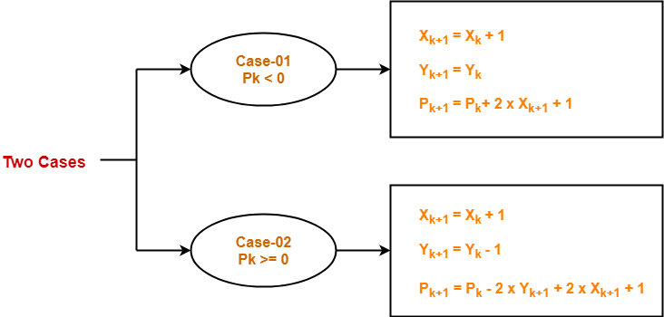
School of Computing Science and Engineering
Course Code : BTCS2401 Course Name:Computer Graphics
Add your content here
Name of the Faculty: M.Arvindhan Program Name: B.Tech

Slide 5
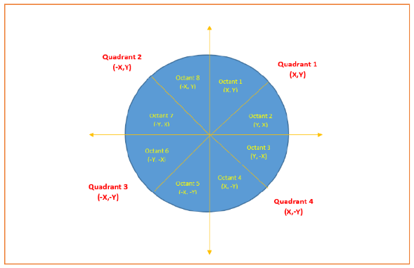
School of Computing Science and Engineering
Course Code : BTCS2401 Course Name:Computer Graphics
Mid Point Circle
Add your content here
Name of the Faculty: M.Arvindhan Program Name: B.Tech

Slide 6
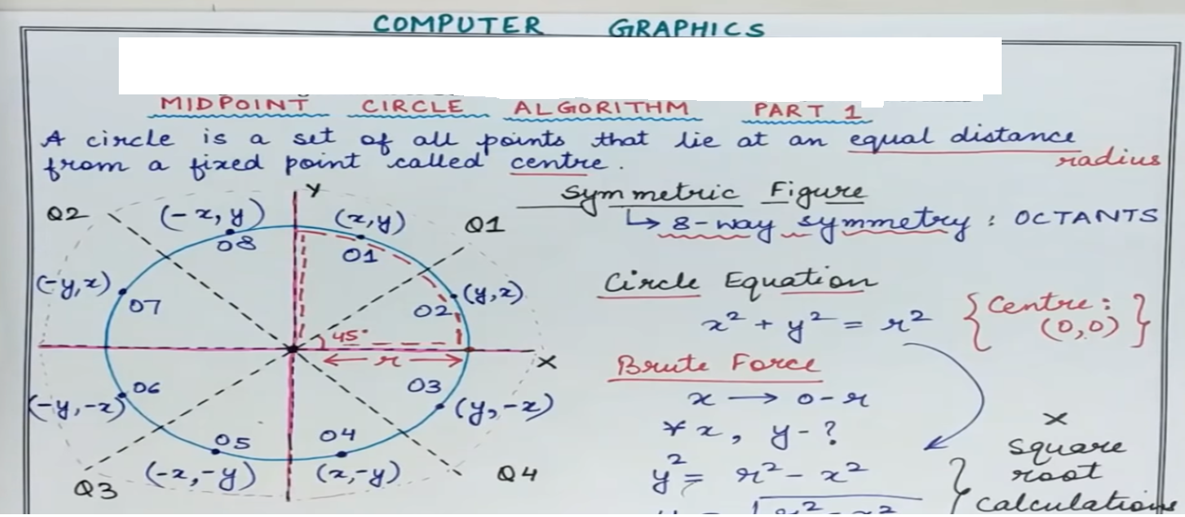
School of Computing Science and Engineering
Course Code : BTCS2401 Course Name:Computer Graphics
School of Computing Science and Engineering
Course Code : BTCS2401 Course Name:Computer Graphics
Add your content here
Add your content here
Name of the Faculty: M.Arvindhan Program Name: B.Tech

Slide 7
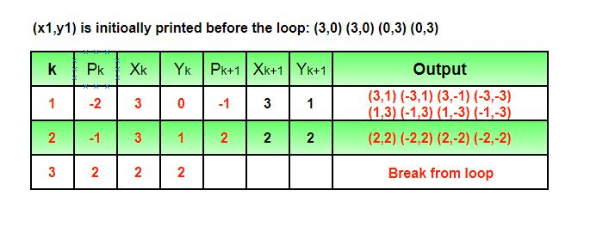
School of Computing Science and Engineering
Course Code : BTCS2401 Course Name:Computer Graphics
Input : Centre -> (0, 0), Radius -> 3
Output : (3, 0) (3, 0) (0, 3) (0, 3) (3, 1) (-3, 1) (3, -1) (-3, -1) (1, 3) (-1, 3) (1, -3) (-1, -3) (2, 2) (-2, 2) (2, -2) (-2, -2)
Name of the Faculty: M.Arvindhan Program Name: B.Tech

Slide 8
School of Computing Science and Engineering
Course Code : BTCS2401 Course Name:Computer Graphics
The Bresenham Line Algorithm
With the assumptions we have made, the most straightforward
algorithm is very simple:
For X = X_0 to X_1 step 1
determine Y value
SetPixel(X, Y)
Next X
Thus, if we can gure out a fast way to determine the Y value
to turn on, we will be done.
There are some aspects of this that are slower than we want.
In particular, we really don't want to be doing any oating
point arithmetic, or oating point comparisons.
First, we have
m =
Y1 􀀀 Y0
X1 􀀀 X0
To get rid of the fraction (so we can work with integers), we'll
multiply by X1 􀀀 X0.
To get rid of the comparison to 1
2, we'll multiply by 2.
Putting these two together, we will use
fraction increment = m 2 (X1 􀀀 X0)
=
Y1 􀀀 Y0
X1 􀀀 X0
2 (X1 􀀀 X0)
= 2 (Y1 􀀀 Y0)
10
Name of the Faculty: M.Arvindhan Program Name: B.Tech

Slide 9
School of Computing Science and Engineering
Course Code : BTCS2401 Course Name:Computer Graphics
The Bresenham Line Algorithm (all
together)
We can write this as:
D(k) = 2Y X(k) 􀀀 2X Y (k)+c
where c = 2Y +2X Y0 􀀀 2Y X0 􀀀X is a constant,
depending only on the input values of (X0; Y0) and (X1; Y1).
Note that since we are assuming X0 < X1, we have X > 0,
and so the decision criterion is still the same.
Now all we need to do is calculate D(k), compare with 0, and
we know which pixel to select next. We can actually do this
iteratively (note: X(k +1) 􀀀 X(k) = 1):
D(k +1) 􀀀 D(k) = (2Y X(k +1) 􀀀 2X Y (k +1)+c)
􀀀 (2Y X(k) 􀀀 2X Y (k)+c)
= 2Y (X(k +1) 􀀀 X(k)) 􀀀 2X((Y (k +1) 􀀀 Y (k))
= 2Y 􀀀 2X((Y (k +1) 􀀀 Y (k))
Name of the Faculty: M.Arvindhan Program Name: B.Tech

Slide 10


